Slide 1
RESEARCH METHODOLOGY
Dr. R C Balabantaray

Slide 2
Meaning
Research is an endeavour to discover answers to intellectual and practical problems through the application of scientific method.
“Research is a systematized effort to gain new knowledge”. -Redman and Mory.
Research is the systematic process of collecting and analyzing information (data) in order to increase our understanding of the phenomenon about which we are concerned or interested.

Slide 3
1.1What is research?
Research is the process of finding solutions to a problem after a thorough study and analysis of the situational factors
Research provides the needed information that guides managers to make informed decisions to successfully deal with problems
The information provided could be the result of a careful analysis of data gathered firsthand or of data that are already available (in the company)

Slide 4
Objectives of Research
The purpose of research is to discover answers through the application of scientific procedures.
The objectives are:
To gain familiarity with a phenomenon or to achieve new insights into it – Exploratory or Formulative Research.
To portray accurately the characteristics of a particular individual, situation or a group – Descriptive Research.
To determine the frequency with which something occurs or with which it is associated with something else – Diagnostic Research.
To test a hypothesis of a causal relationship between variables – Hypothesis-Testing Research.

Slide 5
Characteristics of Research
Research is directed towards the solution of a problem.
Research is based upon observable experience or empirical evidence.
Research demands accurate observation and description.
Research involves gathering new data from primary sources or using existing data for a new purpose.
Research activities are characterized by carefully designed procedures.
Research requires expertise i.e., skill necessary to carryout investigation, search the related literature and to understand and analyze the data gathered.
Research is objective and logical – applying every possible test to validate the data collected and conclusions reached.
Research involves the quest for answers to unsolved problems.
Research requires courage.
Research is characterized by patient and unhurried activity.
Research is carefully recorded and reported.

Slide 6
SCIENTIFIC METHOD
‘Science’ refers to the body of systematic and organised knowledge which makes use of scientific method to acquire knowledge in a particular field of enquiry.
Scientific method is the systematic collection of data (facts) and their theoretical treatment through proper observation, experimentation and interpretation.
Scientific method attempts to achieve a systematic interrelation of facts by experimentation, observation, and logical arguments from accepted postulates and a combination of these three in varying proportions.

Slide 7
BASIC POSTULATES
IN SCIENTIFIC METHOD
It relies on empirical evidence.
It utilizes relevant concepts.
It is committed to only objective considerations.
It presupposes ethical neutrality.
It results into probabilistic predictions.
The methodology is made known.
Aims at formulating scientific theories.

Slide 8
CRITERIA OF A GOOD RESEARCH
Purpose clearly defined.
Research process detailed.
Research design thoroughly planned.
High ethical standards applied.
Limitations frankly revealed.
Adequate analysis for decision maker’s needs.
Findings presented unambiguously.
Conclusions justified.
Researcher’s experience reflected.

Slide 9
QUALITIES OF A GOOD RESEARCH
Systematic
Logical
Empirical
Replicable
Creative
Use of multiple methods

Slide 10
NEED FOR RESEARCH
EXPLORATION
DESCRIBE
DIAGNOSE
HYPOTHESIS
INDUCTIONS AND DEDUCTIONS

Slide 11
SCOPE / SIGNIFICANCE OF RESEARCH
  RESEARCH FOR DECISION MAKING
  Throws light on risks and uncertainty
  Identify alternative courses of action
  Helps in economic use of resources
  Helps in project identification

Slide 12
  Solves investment problems
  Solves pricing problems
  Solves allocation problems
  Solves decision making issues in HR
  Solves various operational and planning problems of business and industry

Slide 13
  Provides the basis for all government policies in our economic system.
  Helps social scientists in studying social relationships and in seeking answers to various social problems.
  For students, research means a careerism or a way to attain a high position in the social structure.
  For professionals in research, it may mean a source of livelihood.

Slide 14
  For philosophers and thinkers, research means the outlet for new ideas and insights.
  For literary men and women, research means development of new styles and creative work.
  For analysts and intellectuals, research means generalizations of new theories.

Slide 15
PROBLEMS IN RESEARCH
Not similar to science
Uncontrollable variables
Human tendencies
Time and money
Lack of computerization
Lack of scientific training in the methodology of research

Slide 16
Insufficient interaction between university research departments and business establishments
Lack of confidence on the part of business units to give information
Lack of code of conduct
Difficulty of adequate and timely secretarial assistance

Slide 17
Poor library management and functioning
Difficulty of timely availability of published data.
Ignorance
Research for the sake of research-limited practical utility though they may use high sounding business jargon.

Slide 18
ROLE OF RESEARCH
IN
DECISION-MAKING
  Decision-making is the process of selecting the best alternative from the available set of alternatives.
  Management is chiefly concerned with decision-making and its implementation.
  These decisions should be based on appropriate studies, evaluations and observations.
  Research provides us with knowledge and skills needed to solve the problems and to meet the challenges of a fast paced decision-making environment.

Slide 19
  According to Herbert A Simon, decision-making involves three activities:
  Intelligence Activity - scanning the environment for identifying conditions necessary for the decision.
  Designing Activity - identifying, developing and analyzing the alternative courses of action.
  Choice Activity - choosing the best course of action from among the alternatives.

Slide 20
FACTORS THAT AFFECT MANAGERIAL DECISIONS
  INTERNAL FACTORS – factors present inside an organisation such as resources, technology, trade unions, cash flow, manpower etc.
  EXTERNAL FACTORS – factors present outside the organisation such as government policies, political factors, socio-economic factors, legal framework, geographic and cultural factors etc.
  QUANTITATIVE FACTORS – factors that can be measured in quantities such as time, resources, cost factors etc.

Slide 21
  QUALITATIVE FACTORS – factors that cannot be measured in quantities such as organizational cohesiveness, sense of belonging of employees, risk of technological change etc.
  UNCERTAINITY FACTORS – factors which cannot be predicted.

Slide 22
TYPES OF RESEARCH
  Descriptive vs Analytical Research
  Descriptive Research is a fact finding investigation which is aimed at describing the characteristics of individual, situation or a group (or) describing the state of affairs as it exists at present.
  Analytical Research is primarily concerned with testing hypothesis and specifying and interpreting relationships, by analyzing the facts or information already available.

Slide 23
  Applied vs Fundamental Research
  Applied Research or Action Research is carried out to find solution to a real life problem requiring an action or policy decision.
  Fundamental Research which is also known as basic or pure research is undertaken for the sake of knowledge without any intention to apply it in practice.
  It is undertaken out of intellectual curiosity and is not necessarily problem-oriented.

Slide 24
  Quantitative vs Qualitative Research
  Quantitative Research is employed for measuring the quantity or amount of a particular phenomena by the use of statistical analysis.
  Qualitative Research is a non-quantitative type of analysis which is aimed at finding out the quality of a particular phenomenon.

Slide 25
  Conceptual vs Empirical Research
  Conceptual Research is generally used by philosophers and thinkers to develop new concepts or to reinterpret existing ones.
  Empirical Research is a data based research which depends on experience or observation alone. It is aimed at coming up with conclusions without due regard for system and theory.

Slide 26
Some other types of research..
  One-time Research – Research confined to a single time period.
  Longitudinal Research – Research carried on over several time periods.
  Diagnostic Research – It is also called clinical research which aims at identifying the causes of a problem, frequency with which it occurs and the possible solutions for it.
  Exploratory Research – It is the preliminary study of an unfamiliar problem, about which the researcher has little or no knowledge. It is aimed to gain familiarity with the problem, to generate new ideas or to make a precise formulation of the problem. Hence it is also known as formulative research.

Slide 27
  Experimental Research – It is designed to assess the effect of one particular variable on a phenomenon by keeping the other variables constant or controlled.
  Historical Research – It is the study of past records and other information sources, with a view to find the origin and development of a phenomenon and to discover the trends in the past, inorder to understand the present and to anticipate the future.

Slide 28
RESEARCH PROCESS
FF
Review the literature
FF
Review
Concepts
And
theories
Design
Research
(Including
Sample
Design)
Analyse
Data
(Test
Hypothesis
if any)
Formulate
hypothesis
Collect
Data
(Execution)
Interpret
and
report
Define
Research
Problem
Review
Previous
Research
findings
F
F
I
III
IV
V
VI
VII
II
F
F
Feed Back
FF
Feed Forward

Slide 29
STEP-1
DEFINITION
OF THE
RESEARCH PROBLEM

Slide 30
RESEARCH PROBLEM
What is a research problem?
The term ‘problem’ means a question or issue to be examined.
Research Problem refers to some difficulty /need which a researcher experiences in the context of either theoretical or practical situation and wants to obtain a solution for the same.

Slide 31
HOW DO WE KNOW WE HAVE A RESEARCH PROBLEM?
Customer complaints
Conversation with company employees
Observation of inappropriate behaviour or conditions in the firm
Deviation from the business plan
Success of the firm’s competitor’s
Relevant reading of published material (trends, regulations)
Company records and reports.

Slide 32
The first step in the research process – definition of the problem involves two activities:
Identification / Selection of the Problem
Formulation of the Problem

Slide 33
IDENTIFICATION / SELECTION OF THE RESEARCH PROBLEM
This step involves identification of a few problems and selection of one out of them, after evaluating the alternatives against certain selection criteria.

Slide 34
SOURCES OF PROBLEMS
Reading
Academic Experience
Daily Experience
Exposure to Field Situations
Consultations
Brainstorming
Research
Intuition

Slide 35
CRITERIA OF SELECTION
The selection of one appropriate researchable problem out of the identified problems requires evaluation of those alternatives against certain criteria. They are:
Internal / Personal criteria – Researcher’s Interest, Researcher’s Competence, Researcher’s own Resource: finance and time.
External Criteria or Factors – Researchability of the problem, Importance and Urgency, Novelty of the Problem, Feasibility, Facilities, Usefulness and Social Relevance, Research Personnel.

Slide 36
DEFINITION / FORMULATION OF THE RESEARCH PROBLEM
Formulation is the process of refining the research ideas into research questions and objectives.
Formulation means translating and transforming the selected research problem/topic/idea into a scientifically researchable question. It is concerned with specifying exactly what the research problem is.

Slide 37
Problem definition or Problem statement is a clear, precise and succinct statement of the question or issue that is to be investigated with the goal of finding an answer or solution.
There are two ways of stating a problem:
  Posting question / questions
  Making declarative statement / statements

Slide 38
PROCESS INVOLVED IN DEFINING THE PROBLEM
STATEMENT OF THE PROBLEM IN A GENERAL WAY.

Slide 39
UNDERSTANDING THE NATURE Of PROBLEM
SURVEYING THE AVAILABLE LITERATURE

Slide 40
DEVELOPING IDEAS THROUGH DISCUSSIONS
REPHRASING THE RESEARCH PROBLEM

Slide 41
CRITERIA OF A GOOD RESEARCH PROBLEM
Clear and Unambiguous
Empirical
Verifiable
Interesting
Novel and Original
Availability of Guidance

Slide 42
Defining Problem, Results in
Clear Cut Research Objectives..
Symptom Detection
Analysis of
the Situation
Problem Definition
Statement of
Research Objectives

Slide 43
ESTABLISHMENT OF RESEARCH OBJECTIVES
Research Objectives are the specific components of the research problem, that you’ll be working to answer or complete, in order to answer the overall research problem. - Churchill, 2001
The objectives refers to the questions to be answered through the study. They indicate what we are trying to get from the study or the expected results / outcome of the study.

Slide 44
ESTABLISHMENT OF RESEARCH OBJECTIVES
Research Objectives should be clear and achievable, as they directly assist in answering the research problem.
The objectives may be specified in the form of either statements or questions.
Generally, they are written as statements, using the word “to”. (For example, ‘to discover …’, ‘to determine …’, ‘to establish …’, etc. )

Slide 45
STEP-2
REVIEW
OF
LITERATURE

Slide 46
REVIEW OF LITERATURE
Literature Review is the documentation of a comprehensive review of the published and unpublished work from secondary sources of data in the areas of specific interest to the researcher.
The main aim is to find out problems that are already investigated and those that need further investigation.

Slide 47
REVIEW OF LITERATURE
It is an extensive survey of all available past studies relevant to the field of investigation.
It gives us knowledge about what others have found out in the related field of study and how they have done so.

Slide 48
PURPOSE OF REVIEW
To gain a background knowledge of the research topic.
To identify the concepts relating to it, potential relationships between them and to formulate researchable hypothesis.
To identify appropriate methodology, research design, methods of measuring concepts and techniques of analysis.
To identify data sources used by other researchers.
To learn how others structured their reports.

Slide 49
How to conduct the Literature Survey?
Identify the relevant sources.
Extract and Record relevant information.
Write-up the Literature Review.

Slide 50
SOURCES OF LITERATURE
Books and Journals
Electronic Databases
    Bibliographic Databases
    Abstract Databases
    Full-Text Databases
Govt. and Industry Reports
Internet
Research Dissertations / Thesis

Slide 51
RECORDING THE LITERATURE
  The most suitable method of recording notes is the card system.
  The recording system involves use of two sets of cards:
    Source cards (3”x 5”) – used for noting bibliographic information.
    Note cards (5”x 8”) – used for actual note taking.

Slide 52
SOURCE CARDS
  Source Cards serve two purposes:
    Provide documentary information for foot notes.
    It is used for compiling bibliography to be given at the end of the report.

Slide 53
SOURCE CARDS
  Source Cards can be coded by a simple system inorder to relate them to the corresponding note cards.
    Marking a combination of letters and a number on the right hand top corner that begins with ‘C’. For example; C1, C2 etc.
      OR
      Marking the letter ‘B’ or ‘J’ or ‘R’ (B=Books, J=Journal, R=Report) on the left hand top corner.

Slide 54
SOURCE CARDS
  The recording of bibliographic information should be made in proper bibliographic format.
  The format for citing a book is:
  Author’s name, (year), Title of the book, Place of publication, Publisher’s name.
  For Example; Koontz Harold (1980), Management, New Delhi, McGraw-Hill International.
  The format for citing a journal article is:
  Author’s name, (year), Title of the article, Journal name, Volume (number), pages.
  For Example; Sheth J.N (1973), A Model of Industrial Buying Behaviour, Journal of Marketing, 37(4), 50-56.

Slide 55
NOTE CARDS
  Detailed Information extracted from a printed source is recorded on the note cards.
  It is desirable to note a single fact or idea on each card, on one side only.

Slide 56
How to write the review?
  There are several ways of presenting the ideas of others within the body of the paper.
  For Example; If you are referring the major influencing factors in the Sheth’s model of Industrial Buying Behaviour, it can be written as,
  Sheth (1973, p-50) has suggested that, there are a number of influencing factors ……..
  According to Sheth (1973) model of industrial buying behaviour, there are a number of influencing factors……..

Slide 57
How to write the review?
  In some models of industrial buying behaviour, there are a number of influencing factors (Sheth, 1973).
  In some models of industrial buying behaviour, there are a number of influencing factors¹.
    Sheth J.N (1973), A Model of Industrial Buying Behaviour, Journal of Marketing, 37(4), 50-56.

Slide 58
Points to be kept in mind while reviewing literature..
Read relevant literature.
Refer original works.
Read with comprehension.
Read in time.
Index the literature.

Slide 59
STEP-3
FORMULATION
OF
HYPOTHESIS

Slide 60
HYPOTHESIS
A hypothesis is an assumption about relations between variables.
Hypothesis can be defined as a logically conjectured relationship between two or more variables expressed in the form of a testable statement.
Relationships are conjectured on the basis of the network of associations established in the theoretical framework formulated for the research study.

Slide 61
VARIABLES
Anything that can vary can be considered as a variable.
A variable is anything that can take on differing or varying values.
For example; Age, Production units, Absenteeism, Sex, Motivation, Income, Height, Weight etc.
  Note: The values can differ at various times for the same object or person (or) at the same time for different objects or persons.

Slide 62
Variable / Attribute
A variable is a characteristic that takes on two or more values whereas, an attribute is a specific value on a variable (qualitative).
For example;
The variable SEX/GENDER has 2 attributes - Male and Female.
The variable AGREEMENT has 5 attributes – Strongly Agree, Agree, Neutral, Disagree, Strongly Disagree.

Slide 63
Types of Variables
Explanatory vs Extraneous Variable
The variables selected for analysis are called explanatory variables and all other variables that are not related to the purpose of the study but may affect the dependant variable are extraneous.
Dependant vs Independent Variable
The variable that changes in relationship to changes in another variable(s) is called dependant variable.
The variable whose change results in the change in another variable is called an independent variable.
OR
An independent variable is the one that influences the dependant variable in either a positive or negative way.

Slide 64
HYPOTHESIS
Research Hypothesis is a predictive statement that relates an independent variable to a dependant variable.
Hypothesis must contain atleast one independent variable and one dependant variable.

Slide 65
HYPOTHESIS
Hypothesis are tentative, intelligent guesses as to the solution of the problem.
Hypothesis is a specific statement of prediction. It describes in concrete terms what you expect to happen in the study.
Hypothesis is an assumption about the population of the study.
It delimits the area of research and keeps the researcher on the right track.

Slide 66
PROBLEM (VS) HYPOTHESIS
Hypothesis is an assumption, that can be tested and can be proved to be right or wrong.
A problem is a broad question which cannot be directly tested. A problem can be scientifically investigated after converting it into a form of hypothesis.

Slide 67
CHARACTERISTICS OF HYPOTHESIS
Conceptual Clarity - It should be clear and precise.
Specificity - It should be specific and limited in scope.
Consistency - It should be consistent with the objectives of research.
Testability - It should be capable of being tested.
Expectancy - It should state the expected relationships between variables.

Slide 68
CHARACTERISTICS OF HYPOTHESIS
Simplicity - It should be stated as far as possible in simple terms.
Objectivity - It should not include value judgments, relative terms or any moral preaching.
Theoretical Relevance - It should be consistent with a substantial body of established or known facts or existing theory.
Availability of Techniques – Statistical methods should be available for testing the proposed hypothesis.

Slide 69
SOURCES OF HYPOTHESIS
  Discussions with colleagues and experts about the problem, its origin and objectives in seeking a solution.
  Examination of data and records for possible trends, peculiarities.
  Review of similar studies.
  Exploratory personal investigation / Observation.
  Logical deduction from the existing theory.
  Continuity of research.
  Intuition and personal experience.

Slide 70
TYPES OF HYPOTHESIS
Descriptive Hypothesis
These are assumptions that describe the characteristics (such as size, form or distribution) of a variable. The variable may be an object, person, organisation, situation or event.
Examples:
“Public enterprises are more amenable for centralized planning”.

Slide 71
Relational Hypothesis [Explanatory Hypothesis]
These are assumptions that describe the relationship between two variables. The relationship suggested may be positive, negative or causal relationship.
Examples:
“Families with higher incomes spend more for recreation”.
Causal Hypothesis state that the existence of or change in one variable causes or leads to an effect on another variable. The first variable is called the independent variable and the latter is the dependant variable.

Slide 72
Null Hypothesis
When a hypothesis is stated negatively, it is called null hypothesis. It is a ‘no difference’, ‘no relationship’ hypothesis. ie., It states that, no difference exists between the parameter and statistic being compared to or no relationship exists between the variables being compared.
It is usually represented as H_{O} or H_{0 .}
Example:
H₀: There is no relationship between a family’s income and expenditure on recreation.

Slide 73
Alternate Hypothesis
It is the hypothesis that describes the researcher’s prediction that, there exist a relationship between two variables or it is the opposite of null hypothesis. It is represented as H_{A} or H_{1.}
Example:
H_{A}: There is a definite relationship between family’s income and expenditure on recreation.

Slide 74
FORMS OF RELATIONSHIPS
NON-DIRECTIONAL
There IS a relationship between
X & Y
X….linked….Y
Vs DIRECTIONAL
If X goes up, Y ….
or
As X increases, Y…
X = Independent
variable
Y = Dependent variable

Slide 75
DIRECTIONAL HYPOTHESES-
“X” causes “Y” to change
If X changes
(increases
decreases)
then
Y will ______
(increase or
decrease)
a causal link

Slide 76
DIRECTION OF RELATIONSHIP
If X increases, Y increases
A POSITIVE relationship
If X increase, Y decreases
A NEGATIVE or INVERSE relationship
As X changes, Y does NOT change...>
No Change...>NO RELATIONSHIP

Slide 77
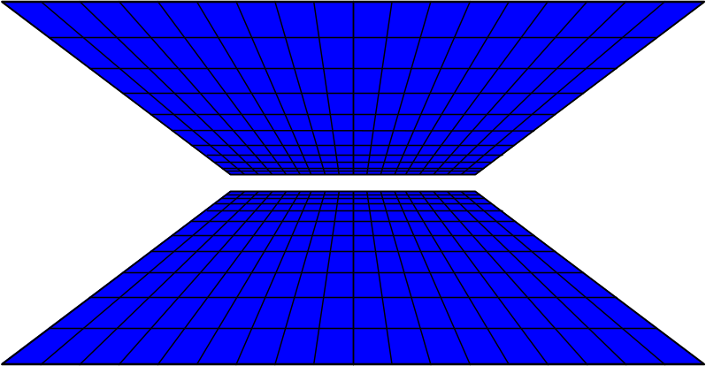
NON-DIRECTIONAL HYPOTHESES
- the weakest form
There Is
a relationship
between X & Y
  non-causal
  correlational statement
  X…..Y

Slide 78
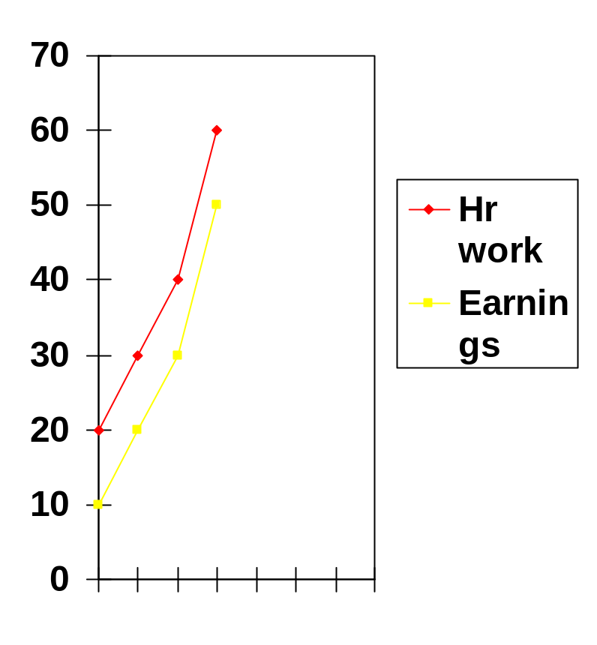
Positive correlation
CORRELATIONAL RELATIONSHIP
When the values of
TWO variables
“go together”
or
values on X & Y
change in SAME
DIRECTION

Slide 79
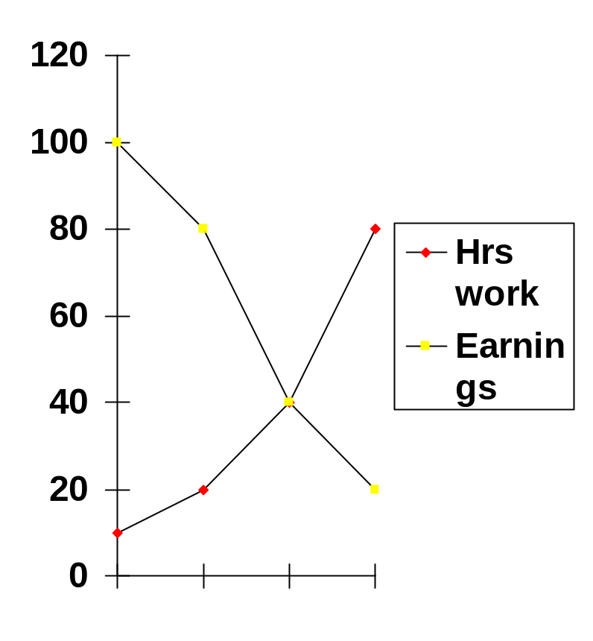
Negative Correlation
When the values of two variables
CO-VARY
in Opposite direction
(as one goes up,
the other goes down)

Slide 80
FUNCTIONS OR ROLE OF HYPOTHESIS
It gives a definite point to the investigation and provides direction to the study.
It determines the data needs.
It specifies the sources of data.
It suggests which type of research is likely to be more appropriate.
It determines the most appropriate technique of analysis.
It contributes to the development of theory.

